Slide 1
Software Testing
Course Instructor
Sobia Usman

Slide 2
Testing Techniques
Black Box or Functional Testing
White Box or Structural Testing

Slide 3
Structural Testing (White box)
We look inside the system and evaluate what it consists of and how is it implemented.
In white box testing the internal structures of the program are analyzed and test cases are devised that can test these structures.

Slide 4
Basic Code Structures and Flow Graph Notation
Sequence
Sequence depicts programming instructions that do not have branching or any control information. So we lump together several sequential instructions in one node of the graph.

Slide 5
Basic Code Structures and Flow Graph Notation
If
Second structural form is the If statement. In the following graph, the first node at the left depicts the if statement and the two nodes next to the first node correspond to the successful case (if condition is true) and unsuccessful case (if condition is false) consecutively. The control comes to the same instruction from either of these intermediate instructions.

Slide 6
Basic Code Structures and Flow Graph Notation
Case
In Case statement, control can take either of several branches (as opposed to only two in If statement.) First node represents the switch statement (C/C++) and nodes in middle correspond to all different cases. Program can take one branch and result into the same instruction.

Slide 7
Basic Code Structures and Flow Graph Notation
While
A while loop structure consists of a loop guard instruction through which the iteration in the loop is controlled. The control keeps iterating in the loop as long as the loop guard condition is true. It branches to the last instruction when it becomes false.

Slide 8
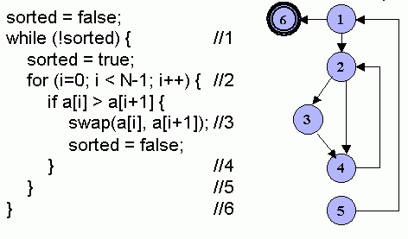
Example – Bubble Sort

Slide 9
Path
A sequence of edges in the flow graph from input to output

Slide 10
Paths
Following are possible paths from starting to the end of this code.
Path1: 1-6
Path2: 1-2-3-4-5-1-6
Path3: 1-2-4-5-1-6
Path4: 1-2-4-2-3-4-5-1-6

Slide 11
White Box Testing - Coverage
Statement Coverage
Branch Coverage
Path Coverage

Slide 12
Coverage
Statement Coverage: In this scheme, statements of the code are tested for a successful test that checks all the statements lying on the path of a successful scenario.
Branch Coverage: In this scheme, all the possible branches of decision structures are tested. Therefore, sequences of statements following a decision are tested.
Path Coverage: In path coverage, all possible paths of a program from input instruction to the output instruction are tested. An exhaustive list of test cases is generated and tested against the code.

Slide 13
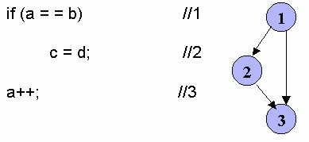
statement coverage
test cases
Input: a = 2, b = 2, d = 3
expected result: a = 3; b = 2; c = 3; d = 3

Slide 14
branch coverage
test cases
Input: a = 2; b = 2; c = 3; d = 4
expected result: a = 3; b = 2; c = 4; d = 4
input: a = 1, b = 2; c = 3; d = 4
expected result: a = 2; b = 2; c = 3; d = 4

Slide 15
path coverage
test cases
Input: a = 2; b = 2; c = 3; d = 4
expected result: a = 3; b = 2; c = 4; d = 4
input: a = 1, b = 2; c = 3; d = 4
expected result: a = 2; b = 2; c = 3; d = 4

Slide 16
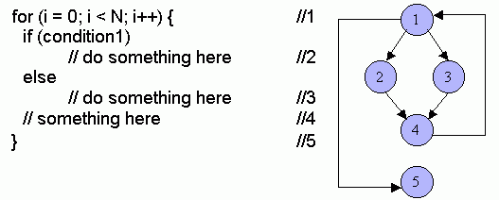
Paths in a Program Containing Loops
Now we shall apply the path coverage scheme on a piece of code that contains a loop statement and see how many test cases can possibly be developed.

Slide 17
Paths
The following is an analysis of the mentioned code and the flow diagram. It determines the number of paths against different iterations of the loop.
N = 0: If the control does not enter into the loop then only one path will be traversed. It is 1-5.
N=1: Two different paths can possibly be traversed (depending on condition).
1-2-4-1-5
1-3-4-1-5
N=2: Four possible paths can be traversed.
1-2-4-1-2-4-1-5
1-2-4-1-3-4-1-5
1-3-4-1-2-4-1-5
1-3-4-1-3-4-1-5
Generalizing the relation between loop variable N and the number of possible paths, for the value of N, 2^{N} paths are possible
Thus if N = 20 it means more then 1 million paths are possible.

Slide 18
A simple graph with many paths

Slide 19
Cyclomatic Complexity
Quantitative measure of the logical complexity of a program.
Number of independent paths in the basis set of a program.
Upper bound for the number of tests that must be conducted to ensure that all statements and branches have been executed at least once.
Cyclomatic Complexity, V (G), for a flow graph G is defined as:
V (G) = E - N + 2
Where E is the number of edges and N is the number of nodes in the flow graph G.
Cyclomatic complexity provides us with an upper bound for the number of independent paths that comprise the basis set.

Slide 20
Cyclomatic Complexity
Number of edges = 8
Number of nodes = 6
C (G) = 8-6+2 = 4
Paths to be tested
Path1: 1-6
Path2: 1-2-3-4-5-1-6
Path3: 1-2-4-5-1-6
Path4: 1-2-4-2-3-4-5-1-6

Slide 21
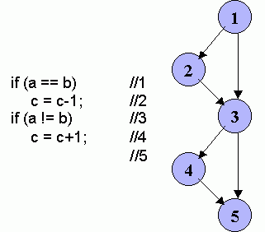
Infeasible Paths
Infeasible path is a path through a program that is never traversed for any input data.
there are two infeasible paths that will never be traversed.
Path1: 1-2-3-4-5
Path2: 1-3-5

Slide 22
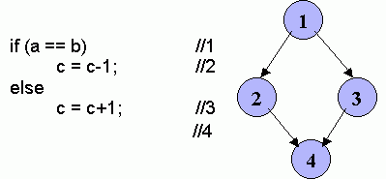
Modified Code
Infeasible paths can be analyzed and fixed.

